Slide 1
Premier League: How to Survive

Slide 2

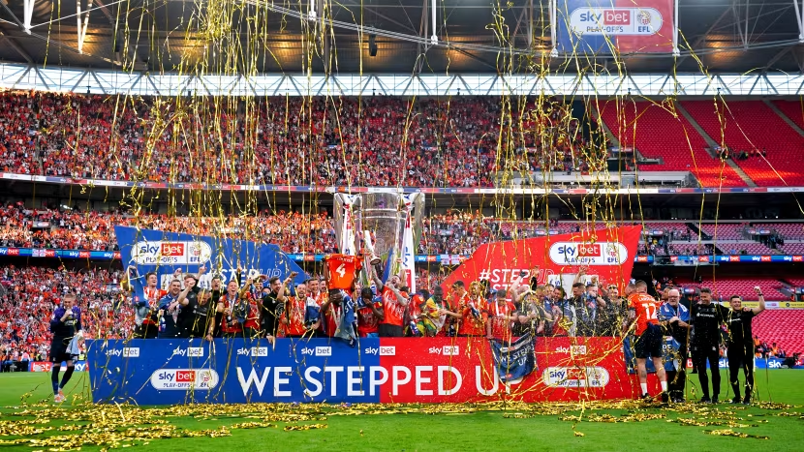
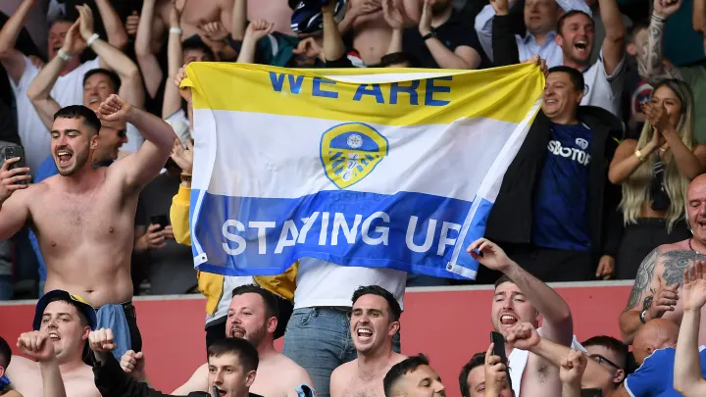
Overview and Problem Statement
Promotion to Premier League: $211 Million
Staying in the Premier League: $311 Million
How do we Stay in the Premier League?
Notes:
Where numbers are coming from: https://www.cnn.com/2023/05/27/football/championship-playoff-2023-final-luton-coventry-preview-spt-intl/index.html

Slide 3
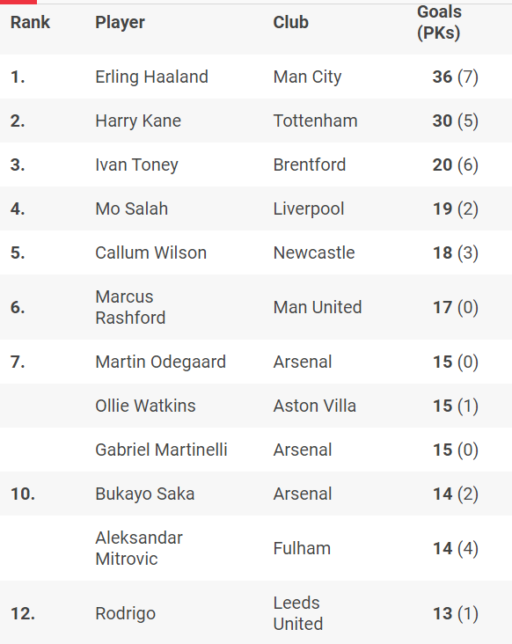
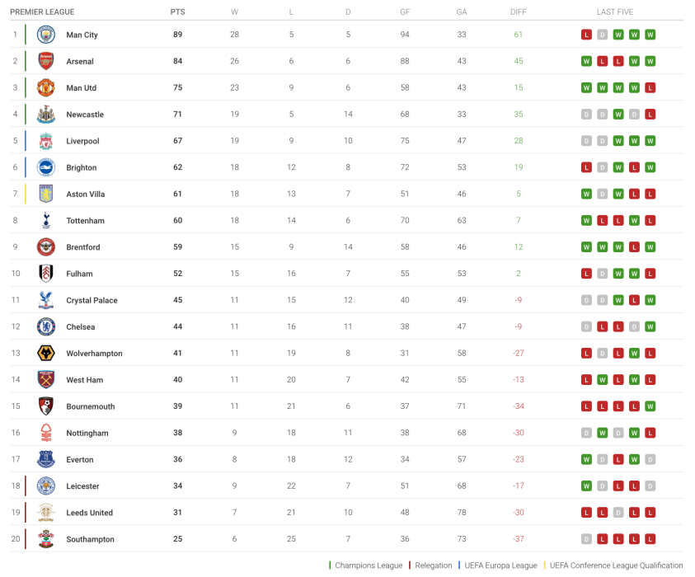
Data Analyzed + What is being Looked Into
What are we Looking into?
We must have 40 points to stay in the league
Having a solid defense is more important than offense
A top goal score is needed to stay in the Premier league
Data Used
Premier League Tables/Stats since its inception in 1992/93 until 2022/23
Notes:
What are we Looking into?
For Points we are going to look at the top relegated team and then add 1 point to understand how each team would survive
For Goals Scored and Goals Against, we will compare teams that are almost relegated (6 points within relegation, as Circled in the picture). And we will compare those teams with the top relegated team to understand what they did differently. The main three things here to look at is How many Goals were scored, how many goals were allowed, and Goal Difference. This will allow us to understand if we need to prioritize allowing less goals or scoring more goals.
For Top Goal Scorer, we will do the same comparison and see you need a person who scores a lot of goals to survive
For the data used, we are using all Premier League Tables. For this data set, we are ignoring any Points Deductions due to skewing the data set. They will still be included but we are showing the points they would have had without the points deduction
I will be comparing the highest placed relegated team versus the teams that were almost relegated. Almost relegated is defined as 6 points or 2 games within getting relegated

Slide 4
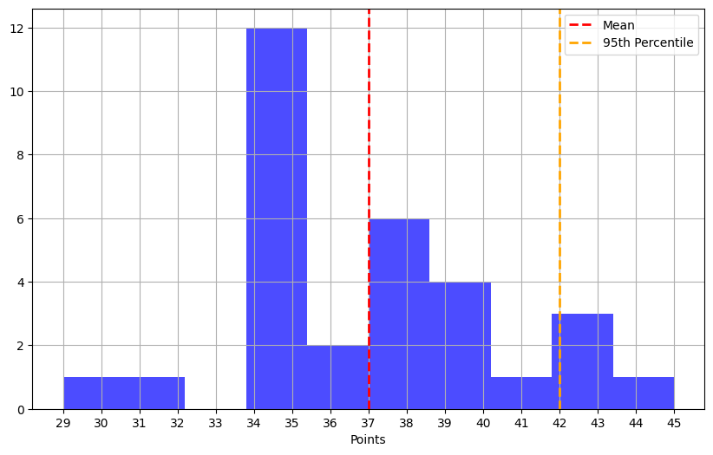
Points Needed to Survive
Average Points Needed to Survive is 37
To Ensure Survival, we should aim for 42 points
Notes:
50% of the time, if we get 37 points, we would survive. The Magical 40 points that everyone mentions, does help you survive 84% of the time and would help you survive. However, historically speaking, if we want to survive, we should shoot for 42 points

Slide 5
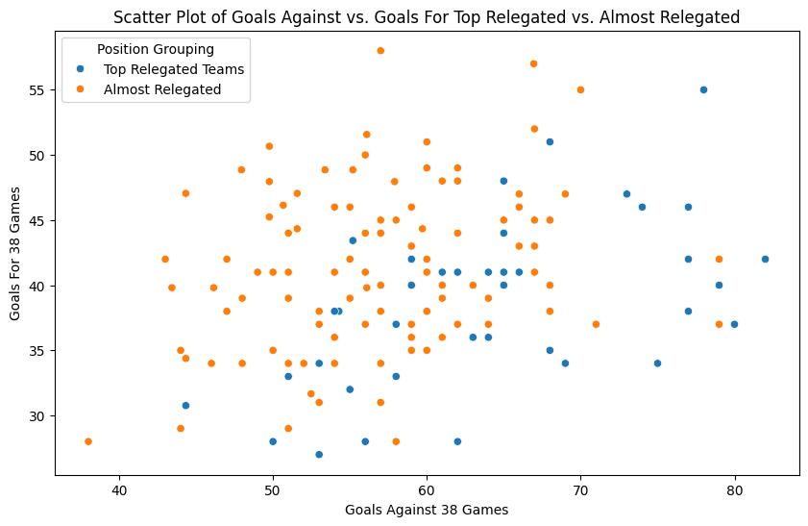
Goals For Versus Goals Against
Blackpool
When teams are allowing 70 or more Goals, very unlikely to stay in the league.
EX: In 2010-11, Blackpool scored 58 goals, which ranked 12th in the league, but still got relegated due to 78 goals allowed
Allowing less than 44 guarantees safety
EX: Leeds in 96-97 only scored 28 goals but only allowed 38 which was enough to stay up
Leeds
Notes:
Can get relegated even with a Goals Against significantly lower than the Median for Teams within 6 Points of Relegation: Crystal Palace in 1994/95 got relegated even after ranking 8th out of 22 teams in Goals Against and having 44 Goals Against

Slide 6
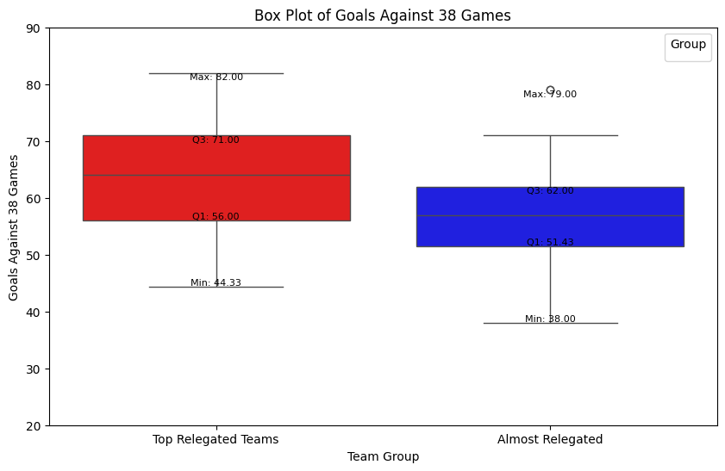
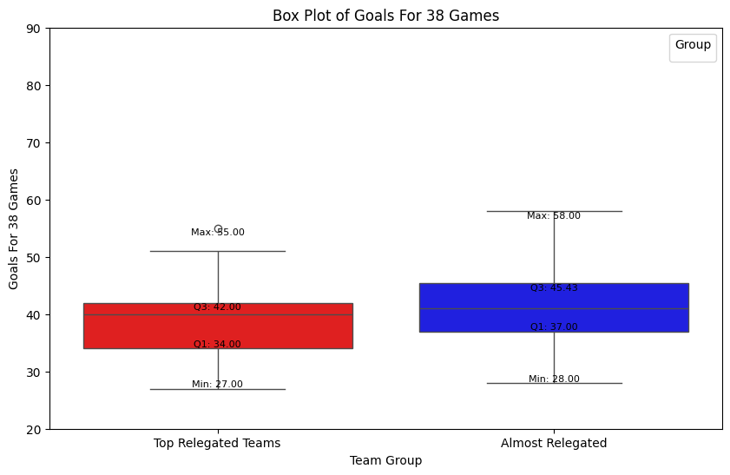
Goals For Versus Goals Against
Bigger gaps between Top Relegated teams in Goals Against than Goals For.
Therefore, should prioritize defense over offense in the summer when buying players
Notes:
Can get relegated even with a Goals Against significantly lower than the Median for Teams within 6 Points of Relegation: Crystal Palace in 1994/95 got relegated even after ranking 8th out of 22 teams in Goals Against and having 44 Goals Against

Slide 7
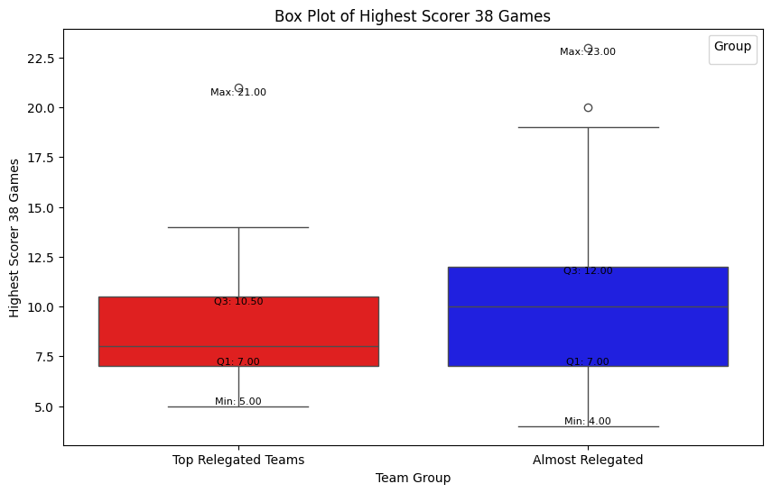
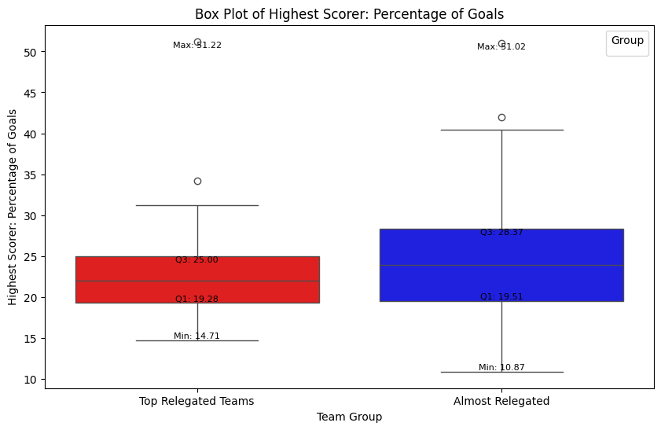
Importance of Top Goal Scorer
Marginal differences when comparing the Top Goal Scorer for Top Relegated Teams and Almost Relegated teams
Notes:
12 Times in Premier League History has someone had over 10 goals and still get relegated. In 2004/05, one person had 21 but Crystal Palace had 41 and finished in the Top Relegation Spot.

Slide 8
Conclusion
Name | AVG of Goals For 38 Games | AVG of Goals Against 38 Games | AVG of Highest Scorer 38 Games
Almost Relegated | 41 | 57 | 10
Top Relegated Teams | 39 | 64 | 9
Difference | 2 | 7 | 1
42 Points to Ensure Survival
Should Prioritize defense over Offense. Therefore, when getting into the Premier League, we should buy defenders + goalie
Should focus on team goals rather than getting a top scorer

